Slide 1
Current and Future issues of AI and Cyber Security
Dr Jorge Blasco Alis
Senior Lecturer and Head of S3 Lab

Slide 2
What is Artificial Intelligence?

Slide 3
What is Artificial Intelligence?
Machines and Algorithms
Perceive
Reason
Act (hopefully intelligently)
Learn
Data
Experts
Notes:
That, Perceive
Reason based on those perceptions and previous knowledge
Act (hopefully intelligently)
Learning -> From previous data or expert knowledge

Slide 4
How does AI fit with Cyber Security?
Defensive AI
Using AI and Machine Learning to identify threats
Patterns and classification
Offensive AI
Attack AI systems
Attack systems using AI

Slide 5
Attacking AI Systems

Slide 6
AI System Pipeline – Malware Identification
Data Acquisition
Feature
Extraction
Training
Model Deployment

Slide 7
Data Acquisition
Data Acquisition
Feature
Extraction
Training
Model Deployment
Obtain data to train the machine learning algorithm:
Malware from previously identified samples
Benign and trusted software

Slide 8
Data Acquisition
Data Acquisition
Feature
Extraction
Training
Model Deployment
Attack
Data Poisoning:
Label Malware as benign software
Label benign software as malware

Slide 9
Feature Extraction
Data Acquisition
Feature
Extraction
Training
Model Deployment
Extract relevant features so the algorithm can learn:
Permissions used on Android
Strings from a binary file
Program behaviour

Slide 10
Feature Extraction
Data Acquisition
Feature
Extraction
Training
Model Deployment
Attack
Modify data so malicious behaviour is not in features:
Change permissions requested by malware
Only activate malicious behaviour in very specific circumstances
Change code so it introduces features seen in benign samples

Slide 11
Training
Data Acquisition
Feature
Extraction
Training
Model Deployment
Split data into train and validation sets and train ML model

Slide 12
Training
Data Acquisition
Feature
Extraction
Training
Model Deployment
Attack
Take advantage of how systems learn to modify their predictions
Thanks to attacks on previous stages

Slide 13
Model Deployment
Data Acquisition
Feature
Extraction
Training
Model Deployment
Deploy the model so it can start making predictions

Slide 14
Model Deployment
Data Acquisition
Feature
Extraction
Training
Model Deployment
Attack
Denial of Service
Generate a lot of alerts on the system
Generate malicious traffic so real attack is more difficult to detect

Slide 15
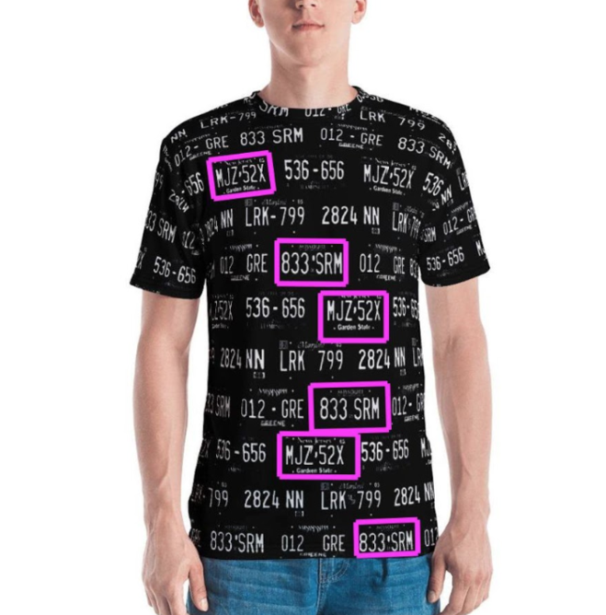
Example – Evading Facial Recognition

Slide 16
Attacking Systems using AI

Slide 17
Cyber Grand Challenge
US Competition Supported by DARPA (2016)
7 teams from US Universities
Goal -> Create an autonomous system
Patches vulnerabilities from binaries
Find and exploit vulnerabilities in other binaries

Slide 18
Results
All teams built successful systems
All based on expert knowledge
One team participated in a competition against humans
They were last but very close and able to solve some challenges in less time

Slide 19
Are these feasible?
Today these are done mostly in academic settings
Intelligence and Military communities actively exploring the application of AI to many scenarios, including cyber security

Slide 20
Summary
Are AI-enabled offensive tools feasible?
Yes
Are they here today?
Not yet
Maybe this means it is the right time to tackle it?

Slide 21
Thank you!

