Slide 1
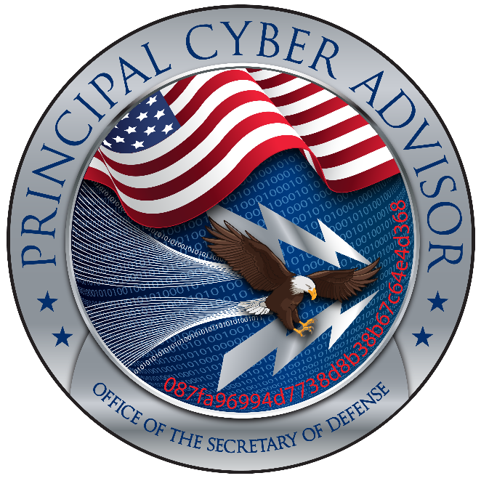
The Cyber security Maturity Model Certification (CMMC)
&
The Defence Industry Base
Note: The following presentation should be considered an expert, not a legal opinion of the authors only and not the US or UK governments, their agencies, departments or ministries

Slide 2
Agenda
Introductions - (5 mins)
US Defence policy and the importance of cyber security (Rear Admiral Chase – 10 minutes)
Intellectual property, Cyber security – John Weiler IT-AAC (15 mins)
Cyber Security Maturity Model Certification (CMMC) Interim Final Ruling and its potential impact on the Defence Industry Base (DIB) – Andy Watkin-Child (15 Mins)
Questions – (All - 40 minutes)

Slide 3
Rear Admiral Chase
The United States recognizes the importance of allies and partners—in developing its policies, building its weapon systems, and planning and conducting its military operations.
The Department of Defense takes seriously cyber threats to its forces, allies, and commercial partners and must act expeditiously to ensure that foreign intelligence services and militaries do not derive substantial advantages from compromises of the broader industrial base.
The Department must ensure that the vendors have invested the energy and resources to protect intellectual property, military secrets, and other sensitive data, including across the entire supply chain, and must facilitate industry’s work in doing so.
Improving the cybersecurity of the Department of Defense’s contractors will require a wide-ranging approach that effectively balances cost and security requirements and industry’s many equities. The Cybersecurity Maturity Model Certification is but one part of such a strategy.

Slide 4
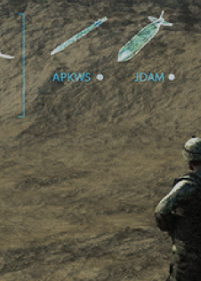
Defense Cyber Strategy Lines of Effort
1
3
4
6
8
TRANSFORM NETWORK AND SYSTEM ARCHITECTURE
NETWORK & INFO SHARING
CYBER WORKFORCE
CROSS DOMAIN
End point mgmt
ENCRYPTION
Identity access mgmt
ENABLERS
OPERATIONALIZE INTERNATIONAL PARTNERSHIPS
EMPOWER TIMELY INTEGRATED CYBER OPS
NETWORK REMEDIATION
Artificial Intelligence
DEVELOP NEXT GEN CAPABILITIES
Secure application development
2
The Cloud
5
7
9
HUMAN FACTORS
Insider Threat
Cybersecurity Culture
DETER ADVERSARIES &
ASSURE CRITICAL MISSIONS
CRITICAL INFRASTRUCTURE
IT PRODUCT/ SUPPLY CHAIN RISK MGMT
PROTECT AND ADVANCE DOD COMPETITIVE ADVANTAGE THROUGH PRIVATE SECTOR PARTNERSHIPS
JOINT INFORMATION OPS
ASSURE CRITICAL MISSIONS
SUPPORT W/INTEL

Slide 5
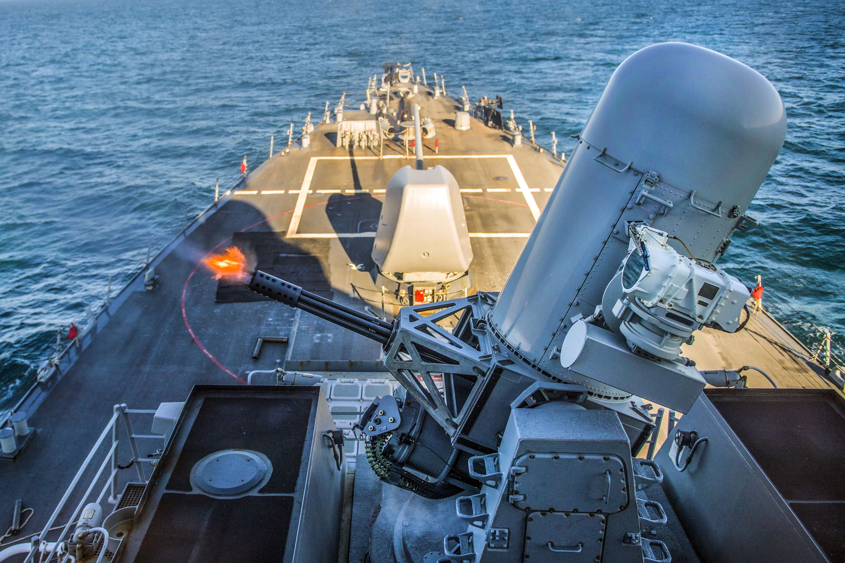
Why create the Cybersecurity Maturity Model Certification (CMMC)?
Increased sophistication and success of cyber attacks on the US DIB.
Cyber attacks cost the US economy between $56BN and $109BN
(2016 ¹).
The US Department of Defence (DoD) plans to invest over $1.8TRN in new weapon systems ².
The increased dependence on digital solutions for the design, manufacture and servicing of new and current defence systems.
Cyber attacks and the theft of the DoDs Intellectual Property (IP) puts the defence capabilities of the US under threat ³.
The ineffective self-attestation of DFARS 252.204-7012.
US Cyberspace Solarium commission recommendations ⁴.

Slide 6
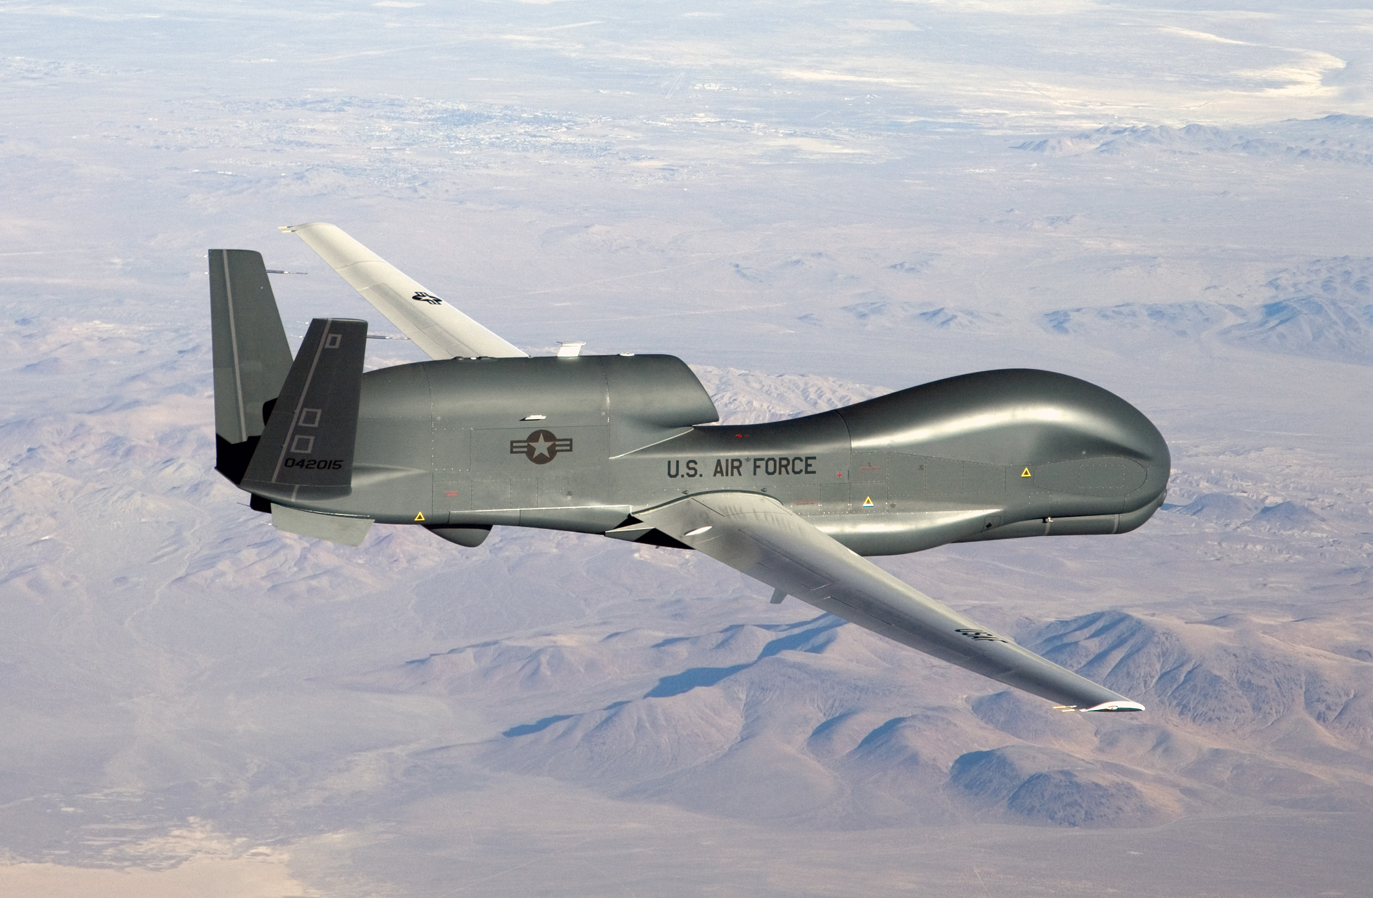
CMMC transformation for cyber standards (NIST SP 800-171)
Office of the UnderSecretary of Defence – Acquisition and Sustainment (OUSD A&S) established the CMMC Programme Office (2018) contracting
John Hopkins Applied Physical Laboratory.
Carnegie Mellon University (CERT) – Cyber Emergency Response Team – (FFRDC).
Creating the CMMC Accreditation Board (CMMC AB) Commissioned in 11.2019.
CMMC AB establishes the implementation guide and training programme for 3rd party CMMC accreditation. (3PAO)

Slide 7
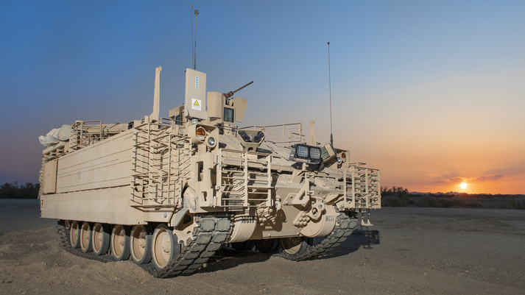
Defense Procurement Regulations – DFARS
Defense Federal Acquisition Requirement Supplement (DFARS)
DFARS 48 CFR § 252.204-7012 - Safeguarding covered defense information and cyber incident reporting ⁵.
NIST (SP) 800 – 171 ⁶.
Self-attestation audited by DoDs Defense Contract Management Agency (DCMA)
DFARS case in 2019 – D041
‘Strategic Assessment and Cybersecurity Certification Requirements ⁷.

Slide 8
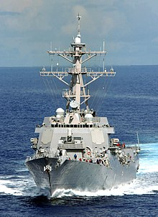
Interim Final ruling – DFARS Case 2018 D041 ^{8,9,10}
‘Strategic Assessment and Cybersecurity Certification Requirements’
The DoD Interim Final Ruling (IFR) for DFARS Case D041 published 29th September 2020. With an effective date of the 30th November 2020.
The IFR set out a 2 part programme for defence contractors and subcontractors to protect Federal Contract Information (FCI) and Controlled Unclassified Information (CUI) and assure compliance before contract award.
Part 1: Contractors and subcontractors to input a ‘basic’ assessment of NIST 800 SP 800 – 171 compliance into the DoD Supplier Performance Risk System (SPRS). The DoD will complete additional medium and high-level oversight.
Part 2: Starting in 2021 CMMC levels (1-5) will be applied to DoD contracts. Contractors and subcontractors must have an appropriate CMMC certificate of compliance awarded by an independent accredited individual.

Slide 9
Interim Final ruling – DFARS Case D041^{8,9,10}
‘Strategic Assessment and Cybersecurity Certification Requirements’
DFARS clause 252.204 – 7019 will be added. Requiring Contractors and subcontractors to assess their compliance to NIST SP 800 – 171.
DFARS clause 252.204 – 7020 will be added. Requiring a contractor to provide government with access to its facilities, systems and personnel. Contractors to ensure that applicable subcontractors also have a current assessment posted in SPRS.
DFARS clause 252.204 – 7021 Cybersecurity Maturity Model Certification (CMMC) will be added. Requiring contractors and subcontractors to have a CMMC certificate of compliance and maintain it for the life of a contract.
In all cases contractors must flow down NIST SP 800 – 171 and CMMC security practices down their supply chain where CUI is identified
Contractors and subcontractor will only be awarded contracts if they have input DOD Assessment results and/ or a CMMC certificate in SPRS

Slide 10
Potential Impact to the Defence Industry Base(DIB)
The ruling assumes that contractors and subcontractors have implemented NIST SP 800 – 171 and incurred the costs of associated cybersecurity requirements. Only additional CMMC requirements incur cost.
Compliance to the ruling will create challenges for the oversight and assurance of CUI protection across international borders.
CMMC assessments can only be carried out by US citizens and C3PAOs can only be owned by US Citizens *.
The NIST and CMMC framework sets a high standard for cyber security compliance. A benchmark which maybe higher than that set within partner nations and across the DIB.
The US DIB is the worlds largest (+200,000 contractors inc. multi-nationals).
The False Claims Act (FCA) – Lincoln Law ¹¹ is the Federal Governments fraud litigation tool.
* As documented by the CMMC Accreditation Body (CMMC – AB). Reciprocity has not yet been agreed

Slide 11
For consideration – next steps
Cybersecurity and CMMC presents opportunities and challenges for Government and the Defence industry Base (DIB).
Compliance to the standard defined by the DoD by the UK DIB is an economic decision, driven by prime contractors outside and inside of the UK.
Compliance requirements to existing DFARS and NIST SP 800 - 171 will have to be mitigated appropriately prior to contract award.
CMMC defines a robust cyber security standard of compliance. Should these or similar standards be adopted by the UK, in support of international trade and cooperation?
In the case of CMMC, data flows (CUI) between partners nations requiring compliance oversight and assurance. How will reciprocity of oversight and assurance be applied between partner nations?
Further comments from Rear Admiral Chase & John Weiler?

Slide 12
Questions

Slide 13
Definitions and Acronyms
References
CMMC – Cybersecurity Maturity Model Certification – US DoD procurement cyber security framework.
CMMC–AB – Cyber Security Maturity Model Certification Accreditation Body. Organisation established under MOU by the DoD to manage global CMMC compliance oversight, assurance and training.
Cyberspace Solarium Commission – Established in 2019 under the National Defense Authorization Act to "develop a consensus on a strategic approach to defending the United States in cyberspace against cyber attacks
DIB – US global Defence Industry Base.
NIST – National Institute of Standards and Technology - Owner and creator of the NIST suite of cyber security standards including NIST SP (Special Publication) 800 – 171.
https://www.whitehouse.gov/wp-content/uploads/2018/03/The-Cost-of-Malicious-Cyber-Activity-to-the-U.S.-Economy.pdf
https://www.gao.gov/assets/710/707359.pdf
https://www.acq.osd.mil/cmmc/
https://www.solarium.gov/
https://www.law.cornell.edu/cfr/text/48/252.204-7012
https://csrc.nist.gov/publications/detail/sp/800-171/rev-1/final
https://www.acq.osd.mil/dpap/dars/opencases/dfarscasenum/dfars.pdf
Interim Final Rule – D041
DFARS Case D041 Interim Final Ruling - A complex road ahead for the international deployment, oversight and assurance of NIST SP 800 – 171 and CMMC
NIST SP 800 - 171 DoD Assessment Methodology (current version 1.2.1)
https://en.wikipedia.org/wiki/False_Claims_Act

Slide 14
REGULATION
&
COMPLAINCE
CYBER
SECURITY
DEFENCE INDUSTRY BASE
NATIONAL
SECURITY
Appendix

Slide 15
What is the CMMC framework
17 Security Domains
The domains including: Access Control, Asset Management, Configuration Management, Incident response, Maintenance, Media Protection, Systems Communications Protection, Systems Information Integrity.
Domains comprises several capabilities to enable security within an organisation. E.g. establish systems access requirements, control internal systems access, control remote systems access and limit access to authorised users and processes for part of the Access Control Domain.
43 Security Capabilities
CMMC defines a total of 171 security practices taken from standards and regulations including NIST SP 800 – 171 and FAR 52.207-22. Applied across 5 levels of cyber security maturity (1 – 5). Level 1(17), Level 2(72), Level 3(130), Level 4 (156) and Level 5 (171).
171 Security Practices
5 Maturity Levels/ processes
CMMC defines 5 levels of cyber security maturity. Level 1(performed, basic hygiene), 2(Documented, intermediate hygiene), 3(Managed, good hygiene), 4(reviewed, proactive) and 5 (optimising (advanced))

Slide 16
Up to 171 security practices applied across 5 levels
Practice Source
171
156
130
NIST (SP) 800-171 B
72
NIST (SP) 800-171 r1
17
FAR 52.207-22/ NIST (SP) 800-171 r1
CMMC Maturity Levels

Slide 17
5 Maturity Levels of increasing complexity
Level 5
Processes
Level 4
Optimising
Practices
Advanced/ Progressive
Level 3
Reviewed
Proactive
Level 2
Managed
Good cyber hygiene
Level 1
Documented
Intermediate cyber hygiene
Performed
Basic cyber hygiene
Basic Safeguarding of FCI
Protection of CUI and reducing the risk of complex cyber threats including Advanced Persistent Threats (APTs)

Slide 18
Andy Watkin-Child
https://www.linkedin.com/in/andywatkinchild/
Founding Partner Parava Security Solutions
andy@parava.org
www.cmmc-eu.com
www.parava.org
John Weiler
https://www.linkedin.com/in/joweiler/
Chairman of the IT Acquisition Advisory Council
Founding Board Member CMMC AB
john@ichnet.org , john.weiler@it-aac.org
www.IT-AAC.org
www.cmmc--coe.org
Capabilities
Cyber security and cyber risk advisory.
Education and awareness
Cyber security and cyber risk strategy
Board governance and oversight
Compliance and Assurance
Cyber organisational design
Cyber NED
Thank you for your time

